Slide 1

Tech Venture Bootcamp 2024
Prof. Manoel Gadi
1

Slide 2

Backend Frameworks
IE University

Slide 3

Outline
What is a framework? Most used frameworks
Why use a framework? Flask Framework
Our Backend API to connect OpenAI API

Slide 4
What is a framework?
A framework (or work environment) is defined as an application or set of modules that allow the agile development of applications through the contribution of libraries and/or functionalities already created.

Slide 5
Most Used Frameworks
Python – Django, Flask, Pyramid, Web2py...
NodeJS – Express, Meteor...
Ruby – Rails, Sinatra, Hobbit...
PHP – Laravel, Codelgniter, Symfony...
Java – Spring, Struct...
C# - .Net

Slide 6
Why to use a framework?
There are several reasons to use frameworks:
Avoid using duplicate code. Use best practices (Model-View-Controller). It allows the use of advanced tools. Faster development.

Slide 7
How to choose a framework?
Factors to consider when choosing a framework are:
Community Support Simplicity and power Reuse Positioning Security

Slide 8

We will use Python Flask
For our Backend API that will connect to OpenAI API

Slide 9
WSGI vs. CGI
PHP uses CGI (Common Gateway Interface) executes the script as a separate process for each request and uses environment variables, stdin, and stdout to "communicate" with it.
Flask uses WSGI (Web Server Gateway Interface) which runs the Python interpreter at the start of the web server, either as part of the web server process (integrated mode) or as a separate process (daemon mode), and loads the script into it. Each request results in a specific function in the script being called, and the request environment is passed as arguments to the function. All Python frameworks use WSGI.

Slide 10

Flask depends ONLY on the Jinja template engine and the Werkzeug WSGI toolkit.

Slide 11

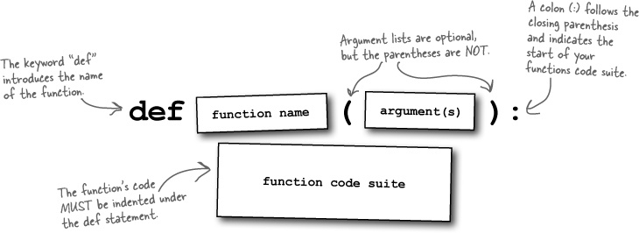
def index():
return "Hello World"

Slide 12
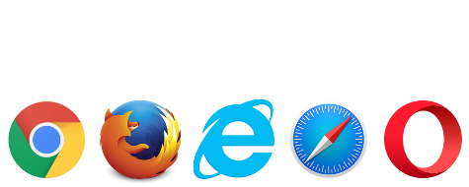


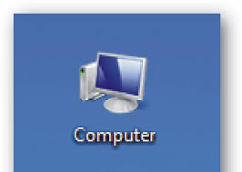

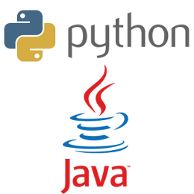
def index():
return "Hello World"
?
?
?
?

Slide 13


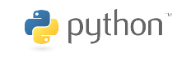
Flask
def index():
return "Hello World"

Slide 14


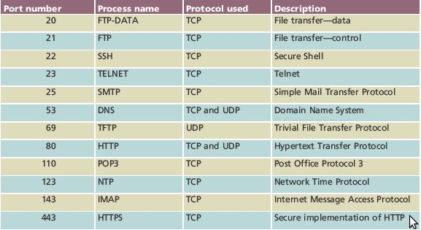
def index():
return "Hello World"
HTML / Javascript / Bootstrap
API / JSON / XML

Slide 15

Flask
from flask import Flask
app = Flask(__name__)
@app.route('/')
def hello_world():
…
return "Hello world, how are you?"
@app.route('/call')
def call_openai():
…
group = str(request.args.get('group', ‘’))
…
prompt = request.args.get('prompt’)
…
completion = client.chat.completions.create(
model="gpt-3.5-turbo",
messages=[
{"role": "user",
"content": r + prompt},
{"role": "system", "content": 'The past conversation was:'+ digest},
]
)
gpt_response = completion.choices[0].message.content
…
response = jsonify(response)
…
return response

Slide 16
HTML / Javascript / Bootstrap

Slide 17
API / JSON / XML

Slide 18
HTML / Javascript / Bootstrap
API / JSON / XML

Slide 19
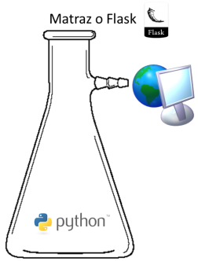
https://ieuniversity.pythonanywhere.com:443/call?group=Ikhlaq&prompt=What%20did%20you%20study?&memory=yes
from flask import Flask
app = Flask(__name__)
@app.route('/')
def hello_world():
return "Hello World"
@app.route('/call')
def call_openai():
…
group = str(request.args.get('group', ‘’))
…
prompt = request.args.get('prompt’)
…
completion = client.chat.completions.create(
model="gpt-3.5-turbo",
messages=[
{"role": "user",
"content": r + prompt},
{"role": "system", "content": 'The past conversation was:'+ digest},
]
)
gpt_response = completion.choices[0].message.content
…
response = jsonify(response)
…
return response
https – http means your data will be transferred using encrypted Hypertext Transfer Protocol, most commonly used over the internet
:443 – 443 is the default HTTPS port when the port is not informed
ieuniversity.pythonanywhere.com resolves to 35.173.69.207 (An Amazon.com address)
/call will call the Python function
“def call_openai()” with the GET parameters:
group=“Ikhlaq”
prompt=“What did you study?
memory=“yes”
GET means that the parameters are visible in the URL in contrast with POST which the parameters are embedded in the message but not visible in the URL.
81.34.60.137 - - [21/Mar/2024:20:34:40 +0000] "GET /call?group=Ikhlaq&prompt=What%20did%20you%20study?&memory=yes

Slide 20
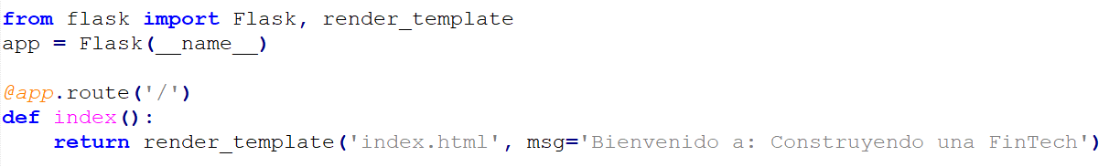
from flask import Flask, render_template
app = Flask(__name__)
@app.route('/')
def index():
return render_template('index.html', msg='Welcome to Tech Venture Bootcamp 2024')

